Slide 1
Payer Analytics
Minimizing EFWA
*EFWA – Error, Fraud, Waste and Abuse

Slide 2
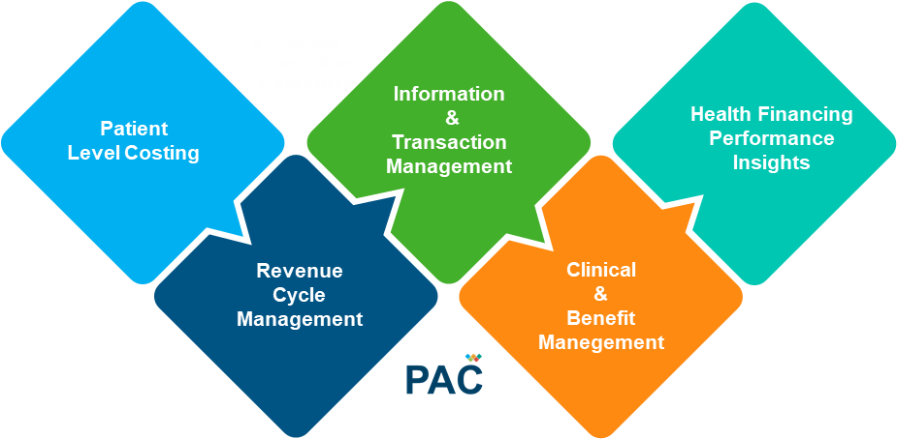
The Health Financing Challenge
1
2
2017 UAE Healthcare Expenditure
18%
Out-of-pocket
82%
Payer-provider
Public, social, donor & private
Optimize
Payer-Provider Ecosystem Operations
Reduce
Waste / Inefficiencies
13+
Billion USD
20%- 40% wasted due to inefficiencies

Slide 3
Waste & Inefficiencies in the Healthcare System
Errors, Fraud, Waste and Abuse
Top Leading causes of Waste in healthcare (as per WHO)
Medicines: underuse of generics and higher than necessary prices for medicines
Medicines: inappropriate and ineffective use
Healthcare products and services: overuse or supply of equipment, investigations and procedures
Healthcare services: inappropriate hospital admissions and length of stay
Healthcare services: medical errors and suboptimal quality of care
Health system leakages: waste, corruption and fraud
Health interventions: inefficient mix/inappropriate level of strategies
Medicines: use of substandard and counterfeit medicines
Health workers: inappropriate or costly staff mix, unmotivated workers
Healthcare services: inappropriate hospital size (low use of infrastructure)
20-40%
of expenditure is wasted due to inefficiencies in the healthcare system (WHO)
10/10
Health IT can help control 10 out of the top 10 leading causes of inefficiencies

Slide 4
Our Approach to Minimize Fraud & Abuse
Intervene
Mistakes results in Errors [e.g. incorrect coding]
Inefficiencies results in Waste [e.g. ordering excessive diagnostics tests]
Bending the Rules results in Abuse [e.g. improper billing practices like upcoding]
Intentional Deception results in Fraud [e.g. billing for supplies that were not provided]
Monitor
Detect
IT
PS
EDU
REG
EMA
IT Solutions
Professional
Services
Education
Regulatory
Support
EFWA
Minimization
Approach
Guides & Regulations
Inspections & Penalties / Awards
Knowingly billing for services not furnished and/or supplies not provided, or both, including falsifying records
Double billing
Billing for more expensive services than were actually provided
Identity theft
Behavioral Change Communication - Educate Payer, Providers, Beneficiaries & Authority
Process Revisions
Logic & Rules Updates
Communication / Helpdesk Support
Internal / Parties Audits
Recover Loses
Grant & Restrict Providers / Beneficiaries
Fraud
Abuse
Waste
Error
Claims Management System (Benefits, Eligibility checks & Adjudication)
Decision Support System (Medical necessity & Quality checks)
Clinical Quality Indicators
Dashboard / BI / Analytics
Support Solutions (transaction managers, patient engagement, coding tools, etc.)
Billing for unnecessary medical services
Charging excessively for services or supplies

Slide 5
How will our solution address F&W across the healthcare journey
Examples, not exhaustive
Authority
Beneficiary
Provider
Physician
Payer/TPA
Encounters and Events
Scheme Related
Start of Event
During & Post Event but Pre-payment
Post Payment
Eligibility
Age Inconsistency
Eligibility check
Cluster, Network Analysis
Benefits & Necessity
Pre Auth rules
Benefits, Medical Necessity checks
Benefits, Medical Necessity checks
Coding Match
Eligibility check
Decision Support System (Medical necessity & Quality checks), coding tools
Audit PreAuth
Billing
Payment Audits
Reconciliation checks
Transaction management engine, patient engagement
Aberrant Tend Analysis
Mass Probability Distribution
Quality of Care
Gradation/ Quality rating
Clinical Quality Indicators
Gradation, Recognition
Trends/Practices
Registration Audits
KPI Evolutions
Incorporate Best Practices
Intermediary Evaluation
KPI Evolutions
Fraud Scoring Engine
Prospective
Retrospective
Predictive

Slide 6
EFWA Detection Models Inventory
Ready to Implement
30 Pros + 12 Retro
2019 Q2
2019 Q4
2019
2020
WIP / Planned
WIP / Planned
7 Pros + 4 Retro + 6 Pred
7 Pros + 4 Retro + 6 Pred

Slide 7
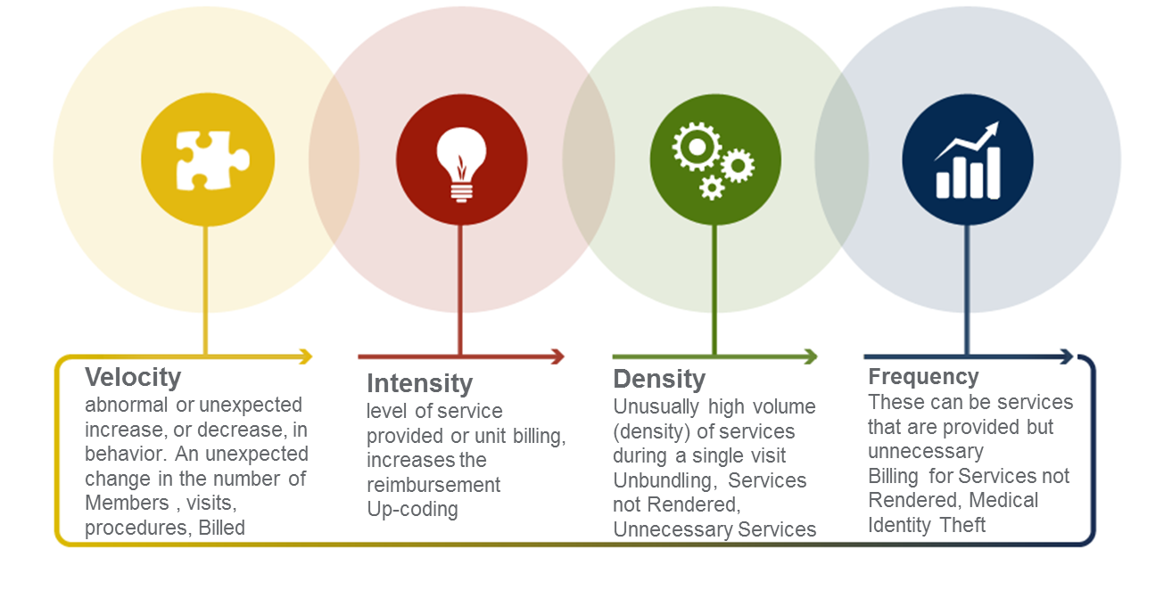
Predictive Fraud Detection Models - Behavior Analysis
Fraud is dynamic and often appears in unusual places, including previously unmonitored areas of healthcare. To find the right suspicious provider, behavioral analysis must be performed, across ALL behaviors. We should capture all behavioral matrix of provider, below are four dimension we should looked into.
AI/ML Technique
Clustering
K-means
Hierarchical Cluster Analysis
Expectation Maximization
Visualization and dimensionality reduction
Kernel PCA
Locally-Linear Embedding (LLE)
t-distributed Stochastic Neighbor Embedding (t-SNE)

Slide 8
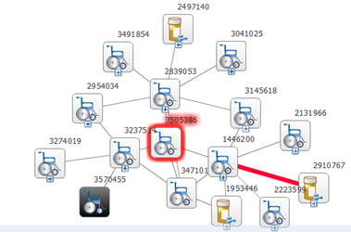
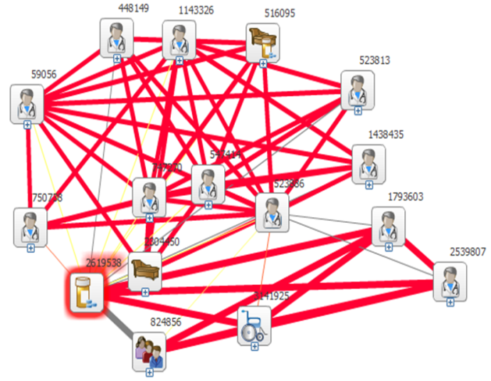
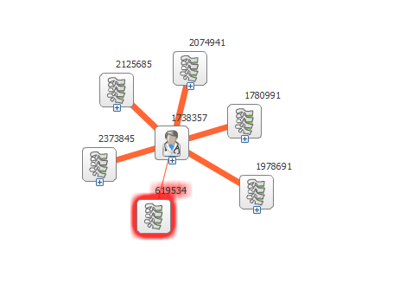
Predictive Fraud Detection Models - Social Network Analysis
Phantom Provider Network
Physician Preference
Chiropractor/PT Collusion
To identify Network of Phantom Providers
To identify collusion between pharmacy and physician
To study the network of Chiropractor
Approach
Identified the phantom providers and identified the network providers link with the above phantom providers
Identified all the pharmacy providers as seed node and built SNA with Physician provider
Identified all the Chiropractor providers as seed node and built SNA with other providers
3 physicians of different states linked with New Jersey pharmacy
4 out of 5 chiropractors are strongly associated with ophthalmologist basis patient sharing
AI/ML Technique
ME
Networks and Graph Theory
Exponential family models
Analysis of nodal covariates
Network autocorrelation, influence, and diffusion
MS
TX
Claim Historical
No services performed
No demographic profile available

Slide 9
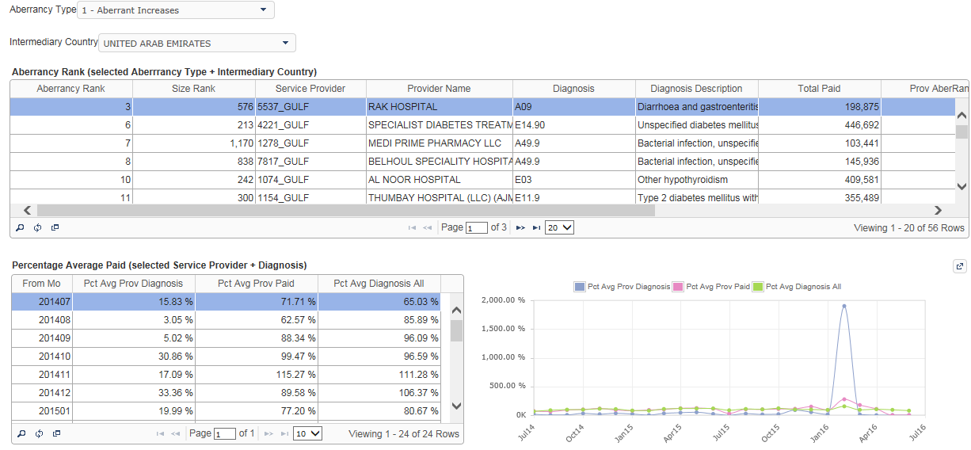
Predictive Fraud Detection Models - Trend Detection Analysis
Measure abnormalities (in provider claims submission. This can identify either spikes (point increase/decrease), or surges (slope increase/decrease) into combination of the following:
Members / Visits / Procedures / Billed/Paid $$
KPIs
# of Members ,
# of Visits
# of Procedures or $ Billed by Provider
Slice by Geographical Location, Specialty , Provider Contract
Report & Review
Review suspicious providers CLAIMS and decide on allegation
Methodology
Time Series moving average / ARIMA, Run Test , 2SD above mean approach to detect spikes in the data

Slide 10




Benford’s Law : Digital Analysis of Fraud Patterns
Statistical Evidence for Fraud in Iranian Election
Prof. Walter Mebane at the University of Michigan applied a 2nd- digit Benford’s test on polling station level data
As a result, Ahmadinejad’s share of vote increased from an average of 0.64 to 0.77
Detection of Fraud committed by Enron Executives
Enron executives were caught for concealing its mushrooming debt using business-financing operations called Special Purpose Vehicle. Benford’s Law helped in detecting a lot of fraud refunds to the tune of $40M
Legal Status
In the United States, evidence based on Benford's law has been admitted in criminal cases at the federal, state, and local levels
Detection of income tax evasion
The digits of interest income and dividend income reported by taxpayers were analyzed for tax frauds
Digital Analysis of scale invariant data depending upon the position of the digit occurring in a number. The expected proportion of the digits is determined by :
P(d)= Log10(1+1/d) (1) Where: d is a number 1, 2 …9, and P is the probability
High Level Process flow
Data Source
Feature Selection
Apply Benford’s Law
FWAE Alert
Claims Data
Claims for Durable Medical Equipment
Billing, Visits, Value etc.,
Suspicious Claims or
Provider
Chi-Square test and
Z – test on First Digit, Second Digit,
First Two Digits, First Three Digits,
and Last Two Digits

